Slide 1


TECHLANE.AI
UI/UX design for the AI product's dashboard
Jahanvi Tharu
tharu.jahanvi215@gmail.com
8318073807
linkedin.com/in/jahanvi-tharu-53a246203/

Slide 2
INTRODUCTION
"Welcome to our AI Product's Admin Dashboard – your control hub for managing AI model performance and user experiences. Streamline tasks, monitor key metrics, and harness data insights effortlessly, all in one intuitive platform. Elevate your AI product management with our user-friendly, powerful admin dashboard."

Slide 3
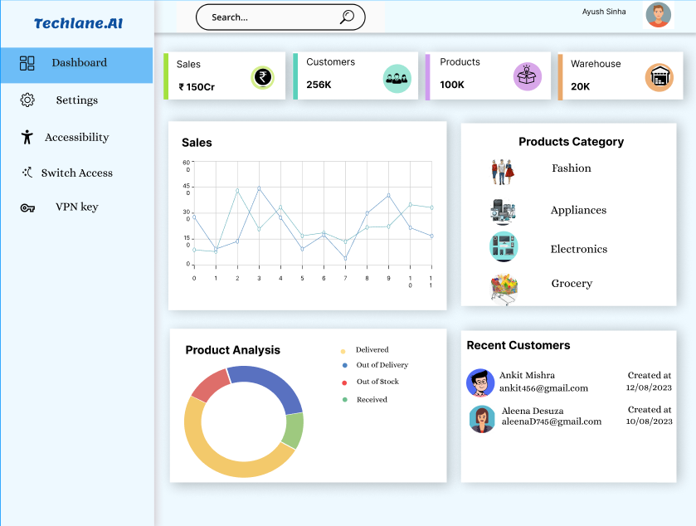
ADMIN DASBOARD

Slide 4

Thought Process
1.Identifying User Needs
2.Defining Key Metrics
3.User Experience (UX)
Understand the roles using the dashboard (administrators, managers) and their goals:
Essential metrics for AI performance evaluation – accuracy, precision, recall – and identify the data
Design an intuitive interface that enables quick access to vital information.
4.Data Visualization
5.Product Management
6.Alerts and Notifications
Choose appropriate charts and graphs to represent AI predictions,
user management
Create functionalities for adding, editing, categorizing, and configuring AI models.
Implement notifications for AI anomalies, low performance, or system irregularities.

Slide 5
Major Advantage
Centralized Control
Data Visualization
Manage AI product operations and data from a single, organized dashboard.
Visualize AI predictions and results through interactive charts and graphs.
Inventory Tracking
Track AI model versions, configurations, and updates for effective management.
User Management
User-friendly UX
Efficiently handle user profiles, roles, and permissions for seamless access control.
Prioritize user experience with intuitive navigation and clear interfaces.

Slide 6
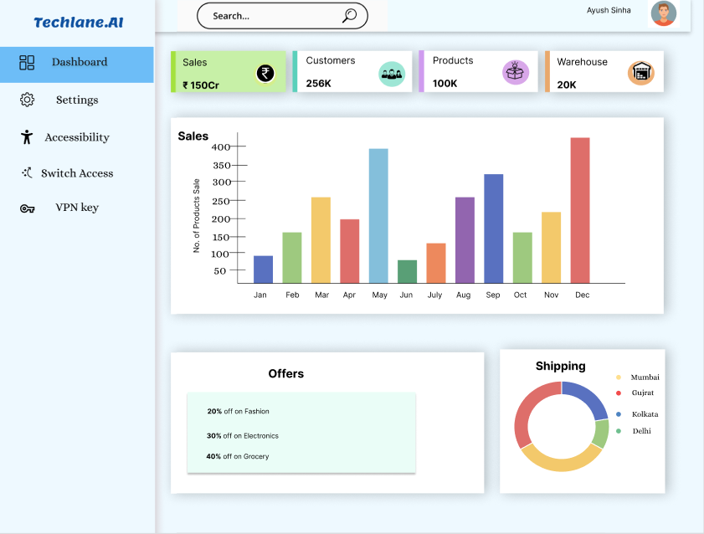
Sales

Slide 7
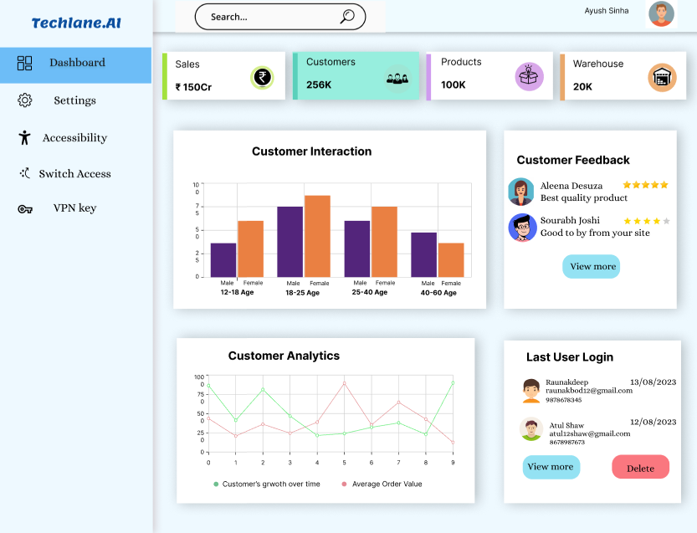
Customers

Slide 8
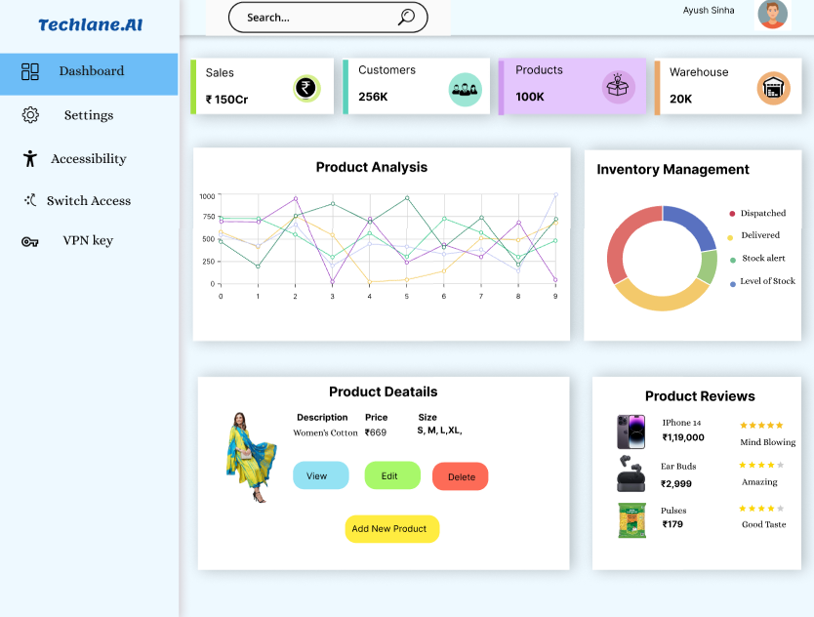
Products

Slide 9
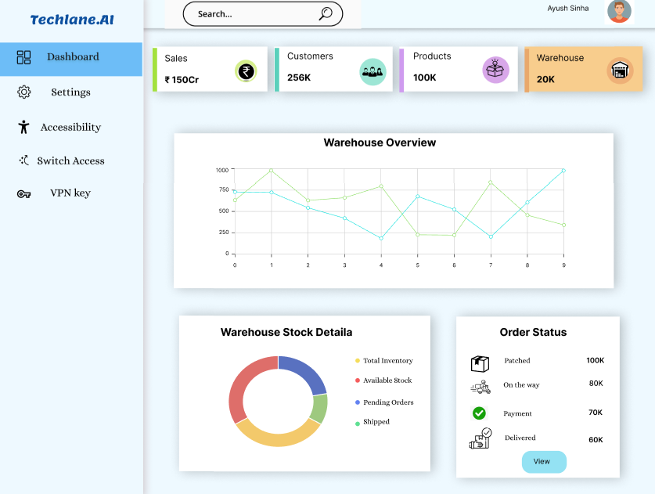
Warehouse

Slide 10


Conclusion
In conclusion, the AI product's admin dashboard is a comprehensive solution for efficient management of AI model performance, inventory, and user interactions. Its user-friendly interface, real-time analytics, and customization options empower administrators to make informed decisions, ensuring seamless operations and enhanced user experiences.
Link to Figma Dashboard
https://www.figma.com/file/LNUqEGS5c3FkIXYU7ZsoSh/Dashboad?type=design&node-id=0%3A1&mode=design&t=qEqiGvaHoSTz5bwf-1

